Slide 1
Mary Shelley
Mary Wollstonecraft Shelley was an English novelist, short story writer, dramatist, essayist, biographer, and travel writer, best known for her Gothic novel Frankenstein.

Slide 2
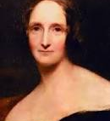

Mary Shelley 30 August 1797 – 1 February 1851

Slide 3
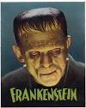
Novenber 21 1931
November 1931

Slide 4
The work came out of a competition proposed by Lord Byron in the summer of 1816 so as who could write the best horror story.
The central idea came to Shelly in a dream where she saw a student putting together parts of a man's body and working through a big engine to animate it.
She first wrote a short story but Percy encouraged her to expand it into a novel.
The novel had at the center of its plot a failed attempt at artificial life, by the scientist Frankenstein, which produced a monster.
The work is considered to be a mixture of science fiction, gothic novel, and having elements from the Romantic movement

Slide 5
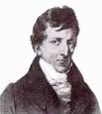
True or false ?
It was partly inspired by the electrical experiments conducted on dead and living animals by the Italian physicist Giovanni Aldini
Frankenstein: or The Modern Prometheus is also seen as a warning about the transformations of man under the Industrial Revolution.

Slide 6
Shelley was particularly interested in folk-lore and local legend.
She was one of the Romantic artists, who valued mysterious heritage over modern industry.
Her step-mother was the English translator of the Brothers Grimm

Slide 7
What are Graphic Novels?
"Graphic Novel" is a format, not a genre. Graphic novels can be fiction, non-fiction, history, fantasy, or anything in-between.

Slide 8
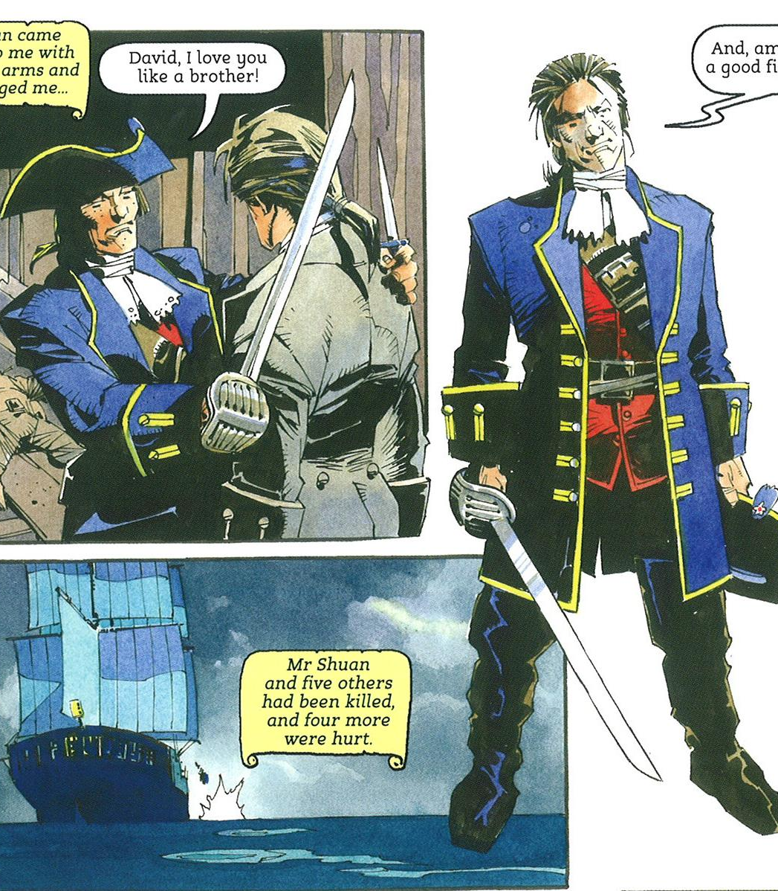
Graphic Novels
They use sequential art to tell a story. Unlike comic books, graphic novels are generally stand-alone stories with more complex plots.

Slide 9
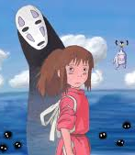
Spirited Away By Hayao Miyazaki
This novel is an adaptation of Miyazaki’s award winning film Spirited Away. Chihiro’s family is moving to a new town. They take a wrong turn off the highway and end up at an abandoned amusement park

Slide 10
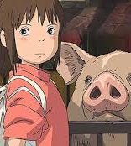
Chihiro’s parents are turned into pigs
and she is trapped in a magical world full of spirits and demons. She must earn her keep at a hotel while she figures out how to get her parents back and get away from this strange world.

